Slide 1



Mission Accepted!
Space Hackathon
Using Canadian satellite data to address problems here on Earth
October 2 - 4, 2026
Goldberg Computer Science Building

Slide 2
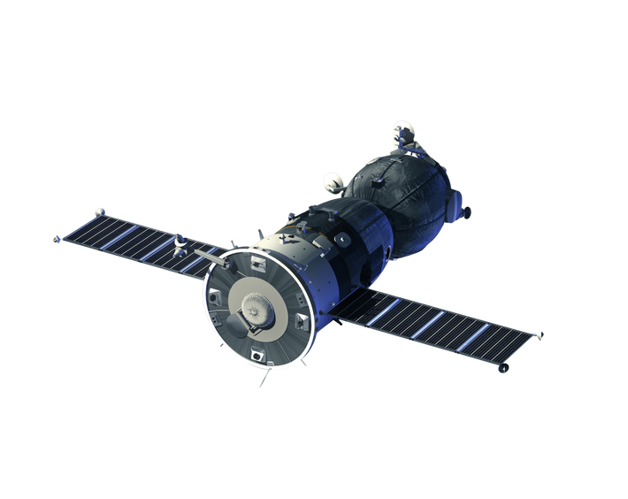
Schedule
FRI |  | SAT |  | SUN
5pm | Registration Starts | 9am | Registration Starts | 9am | Registration Starts
6pm | Kick-off presentation | 12:30pm | Lunch | 12:30pm | Lunch
7pm | Dinner | 6pm | Dinner | 1:30pm | Submission Deadline
9pm | End of day 1* | 9pm | End of day 2 | 2pm | Presentations
 |  |  |  | 4:30pm | Awards & Closing Ceremony
* Teams need to be confirmed by end of day 1.

Slide 3

Who is mda space?
With a 55-year record of firsts and 450+ missions, MDA Space is a trusted space mission partner to the rapidly expanding global space industry. Spanning communications satellites, Earth and space observation, and space exploration and infrastructure, our expertise and innovations are enabling some of the most ambitious missions happening today and making possible our customers’ bold visions for tomorrow.
Building the space between proven and possible, we are pushing boundaries, tackling big challenges, and imagining solutions that inspire and change the world for the better.

Slide 4

Who is SHIFTKEY labs?
ShiftKey Labs is a non-profit organization that empowers students across Atlantic Canada to enhance their tech skills.
From AI and Web Development to Cybersecurity and Game Design, our team shares expertise from within the tech community, enabling students to expand their skills and network with industry professionals.

Slide 5
Who is CSA?
Role of the Canadian Space Agency in Space Utilization
🛰️ Earth Observation
The CSA designs and operates missions the RADARSAT Constellation Mission, using powerful radar to watch over our planet — day or night, rain or shine!
Their data help to:
Track climate change & Arctic ice melt
Manage forests, oceans, and natural resources
Support emergency response to floods, wildfires, and natural disasters
🛰️ Earth Observation
The CSA designs and operates missions the RADARSAT Constellation Mission, using powerful radar to watch over our planet — day or night, rain or shine!
Their data help to:
Track climate change & Arctic ice melt
Manage forests, oceans, and natural resources
Support emergency response to floods, wildfires, and natural disasters

Slide 6
Challenge 1
RADARSAT-2 FOR CHANGE: Turn Pixels into Decisions (Tropical Forest Edition)
The Earth is constantly changing. Can you turn radar observations into actionable intelligence?
Use RADARSAT-2 Tropical Forests data to identify meaningful changes occurring on the ground (Tropical Regions) and transform them into a solution that helps someone understand, monitor or act on those changes.
Your challenge:
Using RADARSAT-2 Tropical Forests data, develop a solution that can help stakeholders detect and understand land changes over time.
Explore different themes:
Deforestation & conservation
Agriculture
Water & wetlands
Disturbances & wildfires
Any other land-change related use case
🎯 What we expect
Create a mandatory visual Value-Added Product (VAP) using RADARSAT-2 Tropical Forests data as a core data source.
The VAP must provide a visual representation of the detected changes, for example:
Change detection map
Interactive map
Spatial visualization of land changes
Before/after or time-series visualization
IMPORTANT : The VAP is mandatory. The additional features should build on the insights provided by the Value-Added Product
The VAP must then be enhanced with complementary features such as:
- Monitoring tools
- Dashboards & analytics
- Alerts / notifications
- Time-series analysis
- Risk or anomaly indicators
- Decision-support tools

Slide 7
Challenge 2
Mission Control aka “Ben’s special challenge ☺”
Space agencies and private launch providers face a complex puzzle: matching a satellite's required orbital parameters with the Earth's rotation, weather patterns, and launch vehicle capabilities. A missed window can cost millions.
Your goal: Build a tool that calculates optimal launch windows based on orbital requirements and provides a user-friendly interface for both mission planners and the general public.
Participants must choose one of the following tracks:
Track 1: The Orbital Architect (Data & Math Focused):
Focus: Solving the "Hard" logic of orbital mechanics.
Core Requirement: Create an engine that takes a "Target Orbit Type" (LEO, Polar, or SSO) and outputs a list of compatible launch dates/times.
The Logic:
  LEO: Calculate windows for inclinations ~45.1°.
  Polar: Calculate windows for inclinations 87.9°–90°.
  SSO: Calculate windows for inclinations ~98.1°.
Advanced Bonus: Incorporate "Vehicle Duration." Does the window account for the time it takes the rocket to reach the injection point, or does it only look at the liftoff moment?
Track 2: The Launch Watcher (UX & Visualization Focused):
Focus: Solving the "Public Interface" and "Engagement" aspect.
Core Requirement: Build a web-based "Launch Dashboard" for the public.
The Features:
  A countdown timer to the next available window.
  A visual representation (2D or 3D) of the launch trajectory or the satellite's path around Earth.
  A "Weather Impact" indicator (Green/Yellow/Red) based on mock or real-time weather API data.
Advanced Bonus: A "Viewing Map" that shows which geographic regions will have the best view of the ascent

Slide 8
Challenge 3
Earth in Motion: Tracking Canada’s Changing Landscape
Climate change is rapidly transforming Canadian ecosystems: shifts in the treeline, permafrost degradation, drying water bodies, ect.
Your challenge:
Develop a prototype application, platform, or educational tool that uses Earth observation data to detect, visualize, or better understand the evolution of a climate-related impact in Canada over time.
Required Data:
RCM (RADARSAT Constellation Mission) — mandatory, using data available through EODMS.
RCM must be used as part of the main analysis, not simply as a complementary dataset.
You may combine RCM with other data sources, such as Sentinel-1, Sentinel-2, optical/radar imagery, ground-based data, or other open datasets.
3 Focus Areas:
Treeline evolution
Permafrost changes
Bodies of water & public safety
Deliverable:
A functional prototype demonstrating how RCM, combined with other Earth observation data, can be used to detect, map, and monitor the evolution of an environmental phenomenon over time, and its impacts on ecosystems, infrastructure, or public safety, such as treeline evolution, drying water bodies, flooding, or permafrost degradation within one of the listed focus areas.

Slide 9
Submissions & presentations
Maximum team size of 5 is recommended
Presentations will take place 2:00 – 4:30 pm on Sunday
The submission deadline is 1:30pm
Each group will have 5 minutes to present, including a demo (if applicable)
Each group must submit a one paragraph overview of their project including a list of your team members and any presentation materials to GitHub
Each group must submit their code to git

Slide 10
Rubric
Section | Description | Poor |  |  |  | Good
Problem/Solution Definition | How clearly the team identifies and understands the problem/solution they are solving. | 1 | 2 | 3 | 4 | 5
Problem Relevancy | Is the scope and feasibility of the problem apparent and is it suitable given the challenges context. | 1 | 2 | 3 | 4 | 5
Problem Significance | How impactful is the problem, is it important given the context of challenges. | 1 | 2 | 3 | 4 | 5
Solution Feasibility | Does the final solution technically adhere with the team's approach, did technical decisions create positive impacts on the approach. | 1 | 2 | 3 | 4 | 5
Solution Viability | Does the final solution harmonize with the goal of the challenge, is the scope aligned with what could be accomplished. | 1 | 2 | 3 | 4 | 5
Solution Originality | Consider the uniqueness and creativity of the solution. Does it leverage something unexpected or solve it differently. | 1 | 2 | 3 | 4 | 5
Problem-Solution Coherency | Does the problem the team set out to solve get accomplished with the final solution. | 1 | 2 | 3 | 4 | 5
Team Presentation | How well did the team present, did everyone contribute, were the ideas presented clear. | 1 | 2 | 3 | 4 | 5

Slide 11
Prices
MDA will award gift cards to the top three teams in the amounts of…
$1000
$800
$600
1st place team
2nd place team
3rd place team
Additionally, the CSA plans to showcase the CSA challenge winning team’s Value-added product (EO challenges 1 and 3) on its LinkedIn platform, with credit to the team. This will give the product visibility among the CSA’s LinkedIn community.

Slide 12
Mentors
 |  | Area of Expertise
Adam Fowler | MDA Space (49North) | Full stack software developer Software design/architecture, automated deployment, & cloud infrastructure knowledge
Ben Harriott | MDA Space | Software developer on distributed systems Software architecture, distributed programming and project planning
Keith Pineo | MDA Space | Full stack software developer Developer on space mission ground segment systems Electrical engineering
Dalia Laoubi | CSA | Mission planner, Working on disaster monitoring (hurricanes, volcanoes, Floods etc.) Acquisitions / Processing of satellite imagery. Development of applications / Strategic planning and engagement.
Bryce McInnes | DeepSense | Data & AI Algorithms
Anastasia Cook | Maritime Launch | 3D modelling Communications Digital design
David Muresan | Maritime Launch | Aerospace Engineer Rocket Design Flight simulations, safety Data monitoring/analyst
Jitansh Arora | MDA Space | Junior Mentor Software Development

Slide 13

Questions?
Mentors will be on site from start until dinner on Saturday and all-day Sunday.
Questions can also be directed to the Discord channel

Slide 14
THANK YOU!

Slide 15




Resources
EODMS
SpaceTrack
Celestrak
CADC
Note: Teams are welcome to use any other Open-Source dataset independently found

